Slide 1
Power BI Dashboards: Comprehensive Analytics
Prepared by: Syed Murtaza Hassan (Murtaza Rizvi)LinkedIn: www.linkedin.com/in/syed-murtaza-hassan-rizvi-736795279Email: hmurtaza510@gmail.com
This project showcases eight fully developed Power BI dashboards, built using real-world datasets and advanced analytical techniques. The report aims to demonstrate BI skills across multiple business domains, provide insights for decision-making, and build a strong portfolio for analytics roles.

Slide 2

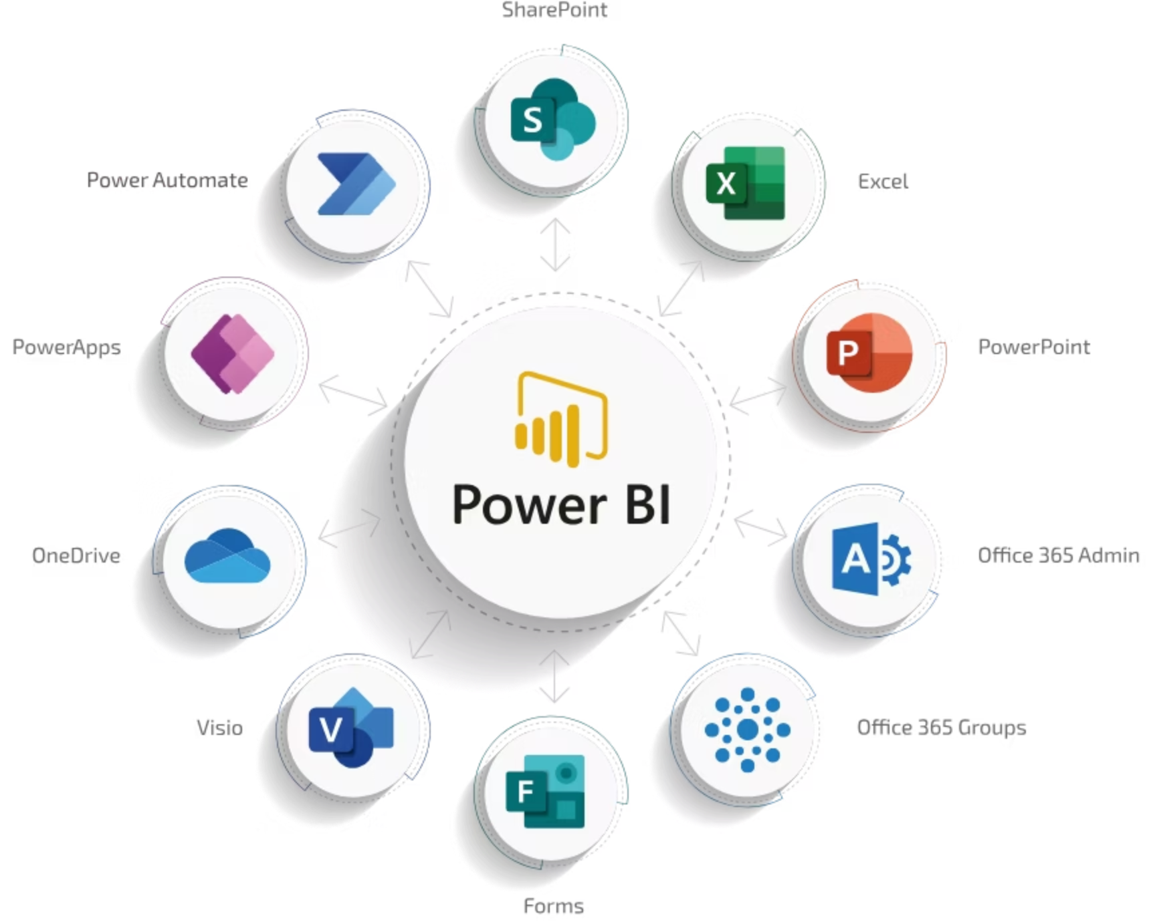
Tools & Techniques Used
Power BI Desktop
For interactive dashboards and reports.
DAX & Data Modeling
Time intelligence, conditional measures, KPIs, and Star Schema.
Power Query
JSON transformation and ETL processes.
Forecasting Models
Predictive analytics for future trends.

Slide 3
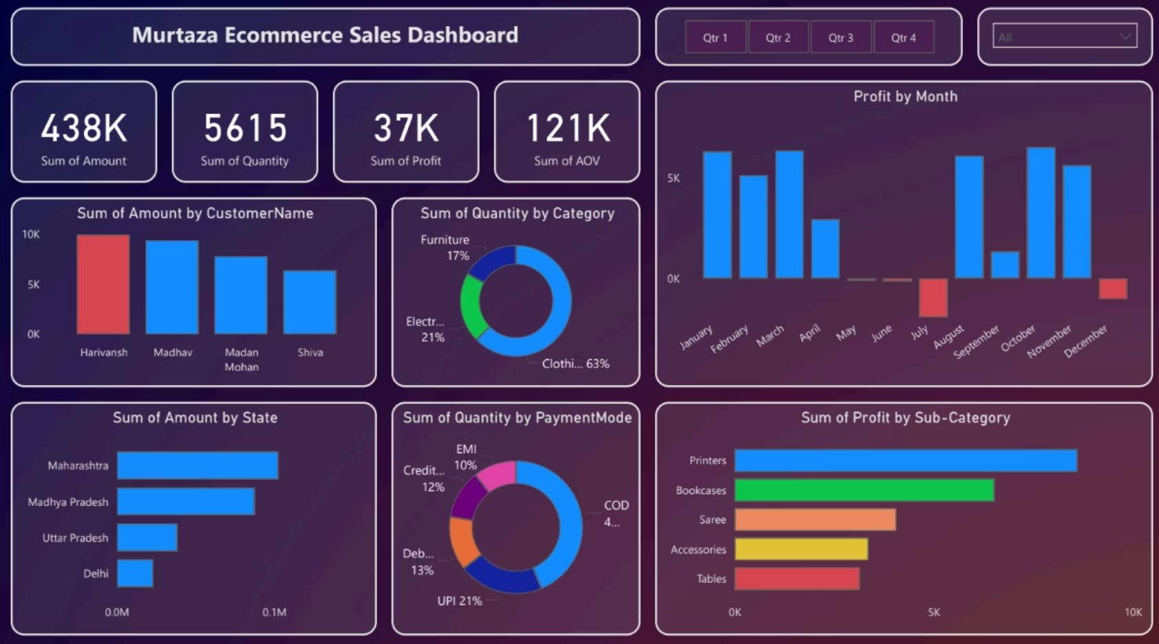
E-Commerce Sales Dashboard
Business Purpose
Trend Insights
Analyze sales, profit, customer behavior, category performance, and state-wise revenue.
Profit fluctuates across months—peaks in Jan, May, Oct.
Top customers include Harivansh, Madhav, Mohan, Shiva.
Key KPIs
Total Sales: ₹438K
Total Quantity: 5615
Total Profit: ₹37K
AOV: ₹121K
Key Insights
Clothing contributed 63% of quantity—highest demand.
Maharashtra & Delhi are top-performing states in sales revenue.
UPI (21%) & COD (13%) are top payment methods.

Slide 4
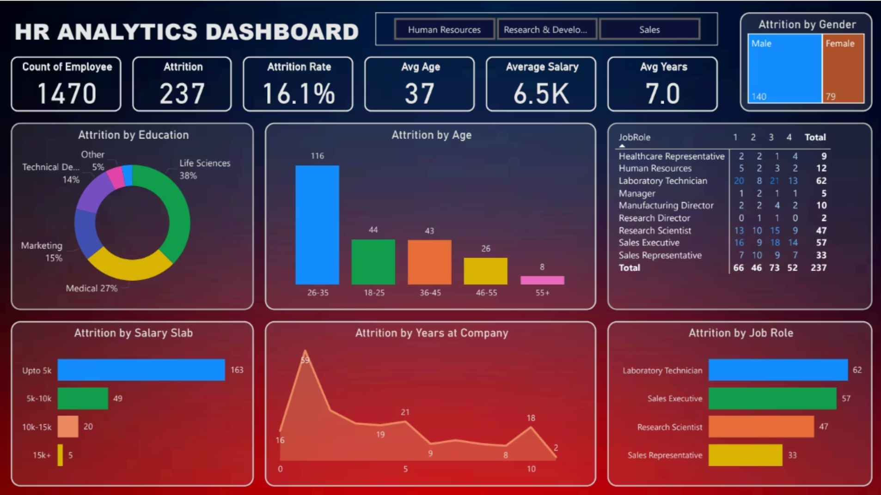
HR Analytics Dashboard
Business Purpose
Trend Insights
Analyze employee attrition and HR-related KPIs to identify workforce trends.
Majority of attrition occurs in Research, Sales, and Technical departments.
Key KPIs
Total Employees: 1470
Attrition Rate: 16.1%
Average Age: 37
Average Salary: 6.5K
Key Insights
Highest attrition in Life Sciences (38%), Marketing (27%), Technical Degree (15%).
Age group 26–35 has the highest attrition (116 employees).
Low salary slabs (Upto 5k) have the highest attrition.

Slide 5

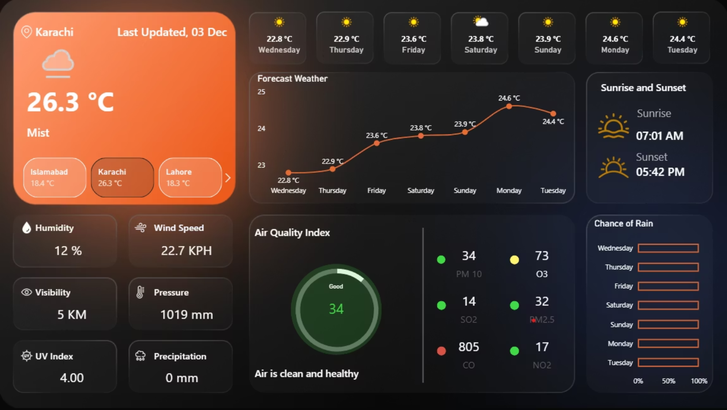
Weather Forecast Dashboard
Business Purpose
Monitor weather conditions for Karachi, Lahore, and Islamabad with AQI analysis.
Trend Insights
Monday & Tuesday show slightly higher temperatures.
Key KPIs (Karachi)
Temperature: 26.3°C
Humidity: 12%
Wind Speed: 22.7 km/h
UV Index: 4
Key Insights
Clear 7-day forecast with slight temperature increase ahead.
AQI Category: Good — Air is clean and healthy.
Rain probability stays low across all days.

Slide 6
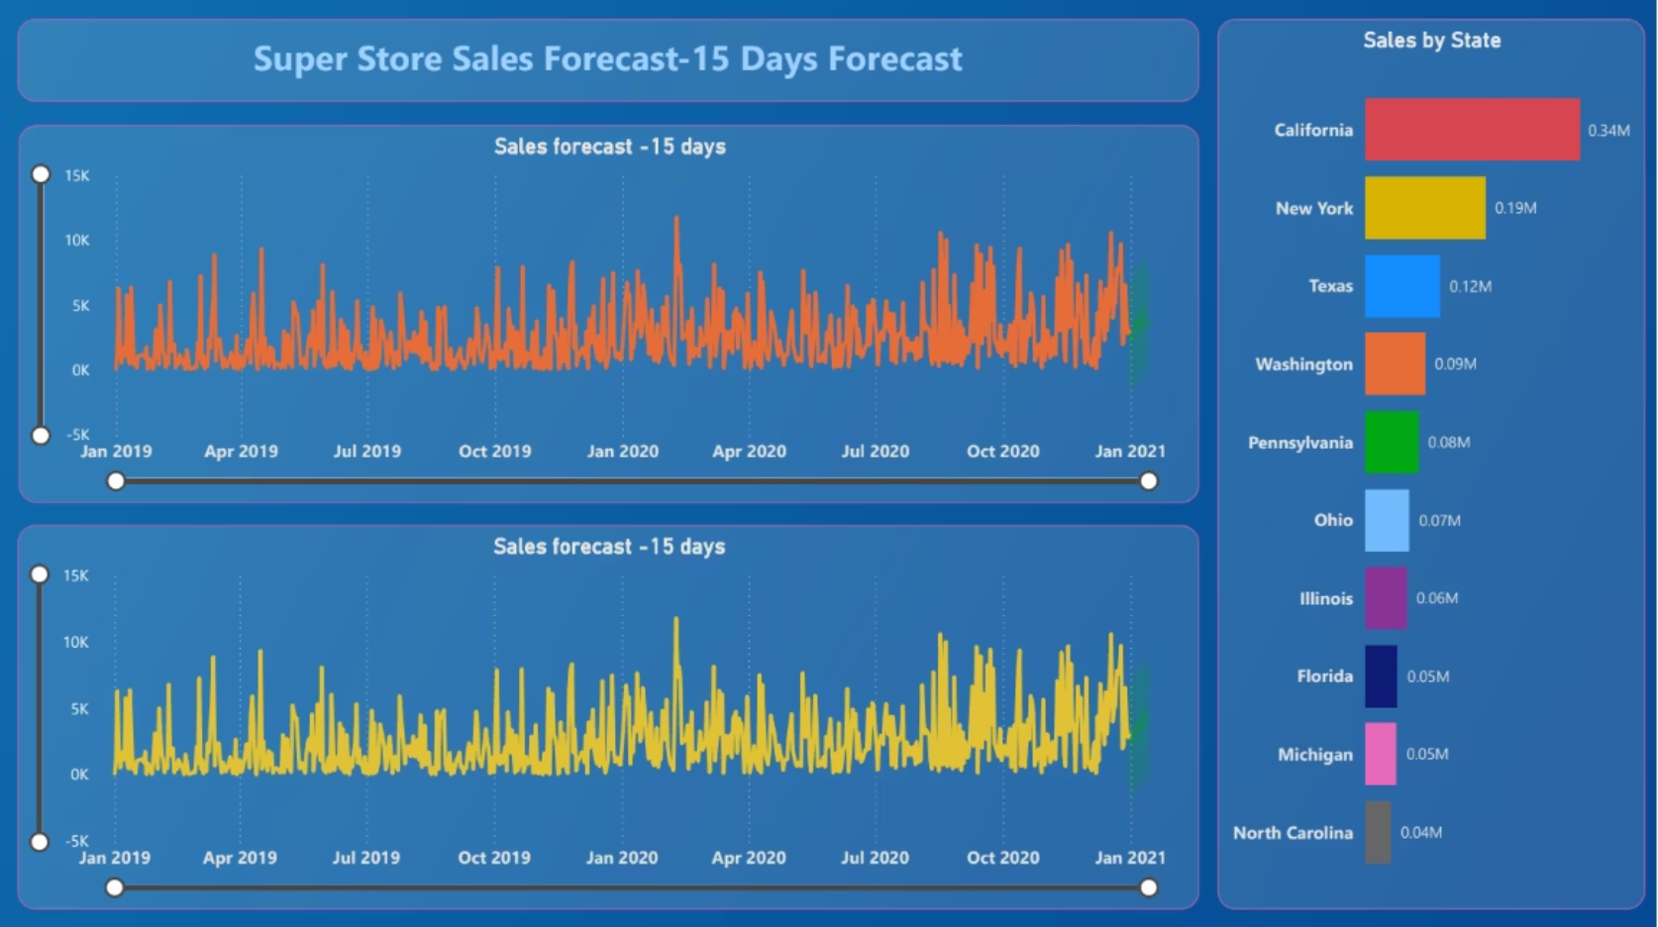
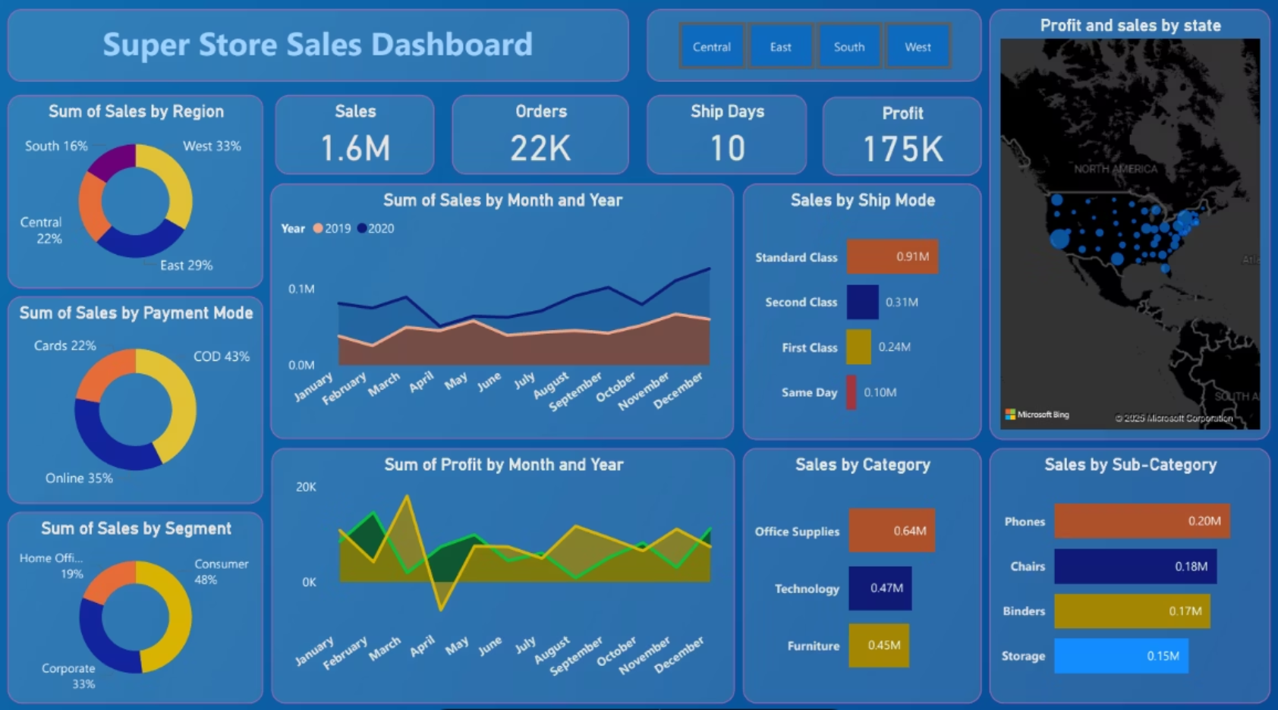
Superstore Sales Dashboard & Forecast
Superstore Sales
Sales Forecast (-15 Days)
Analyze store performance across regions, categories, payment modes, and customer segments.
Predict future 15-day sales using historical data and time series.
Forecast model predicts steady sales between 5K – 15K.
Sales: 1.6M, Orders: 22K, Profit: 175K
Strong states in revenue: California, New York, Texas, Washington.
Office Supplies (0.64M) is top-performing category.
Forecast vs actual lines show close alignment, indicating good model accuracy.
West (33%) and East (29%) are leading regions.
Consistent increasing trend every quarter, highlighting upcoming demand peaks.
Consumer segment contributes nearly 50% of sales.
Sales trend shows strong performance in Q1 & Q4.

Slide 7
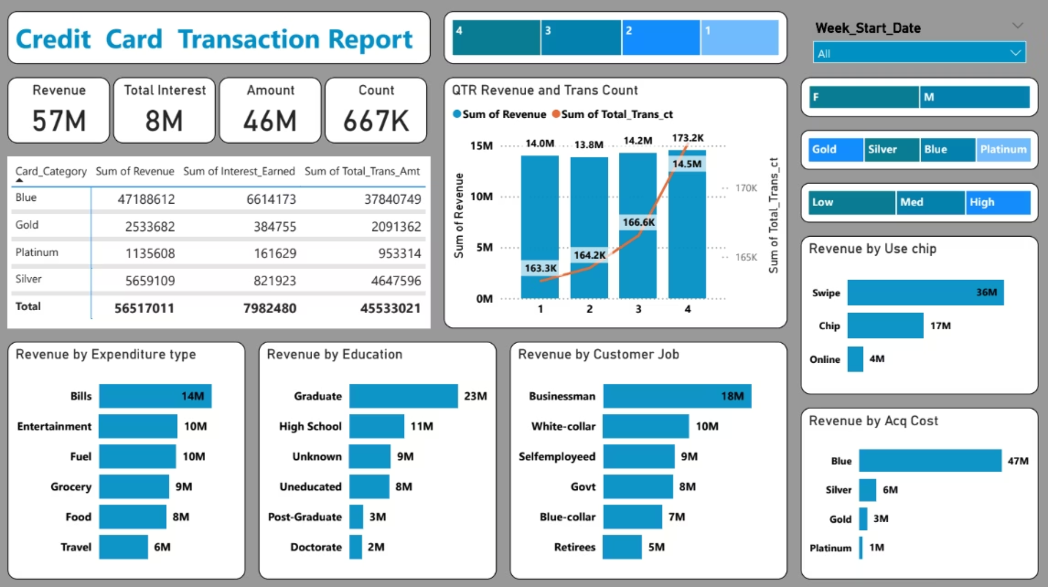
Credit Card Transaction Report
Business Purpose
Trend Insights
Track revenue, transactions, customer behavior, card performance & acquisition costs.
Revenue consistently increases from Q1 → Q4.
Delinquent rate at 6.1%—requires monitoring.
Top KPIs
Revenue: 57M
Total Transaction Amount: 46M
Transaction Count: 667K
Total Interest: 8M
Key Insights
Q4 has the highest revenue (14.5M).
Highest spending categories: Bills, Entertainment, Fuel, Grocery.
Most revenue by education: Graduate (23M).
Top job categories: Businessmen (18M), Self-employed (9M), Govt Employees (8M).
Blue card leads performance with 47M revenue.

Slide 8
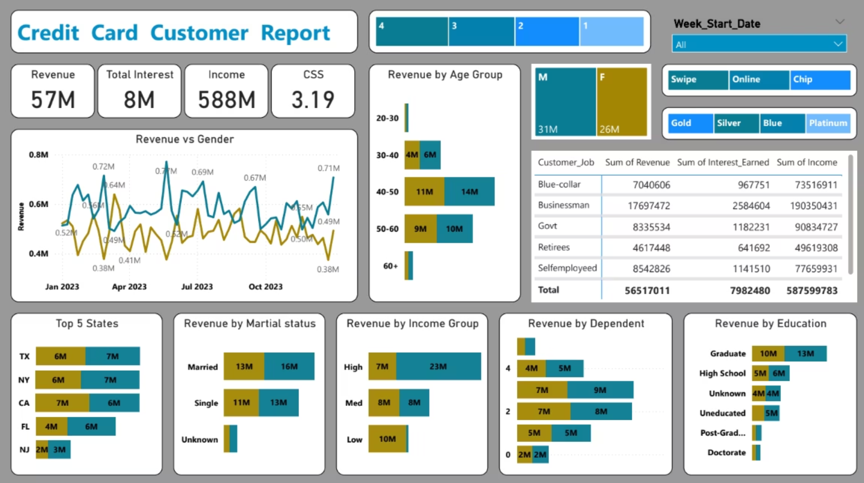
Credit Card Customer Report
Trend Insights
Business Purpose
High correlation between income + spending.
Understand customer demographics, spending behavior, revenue distribution & card performance.
Swipe transactions dominate online/card usage.
Top KPIs
Revenue: 57M
Income: 588M
Interest Earned: 8M
CSS Score: 3.19
Key Insights
Revenue highest among: Age 40–50 group, Male customers, High-income group.
Revenue by Job: Businessman (17.6M), Self-employed (8.5M), Govt (8.3M).
TX, NY, CA, FL, NJ lead revenue by state.
Married customers contribute 16M in revenue.

Slide 9
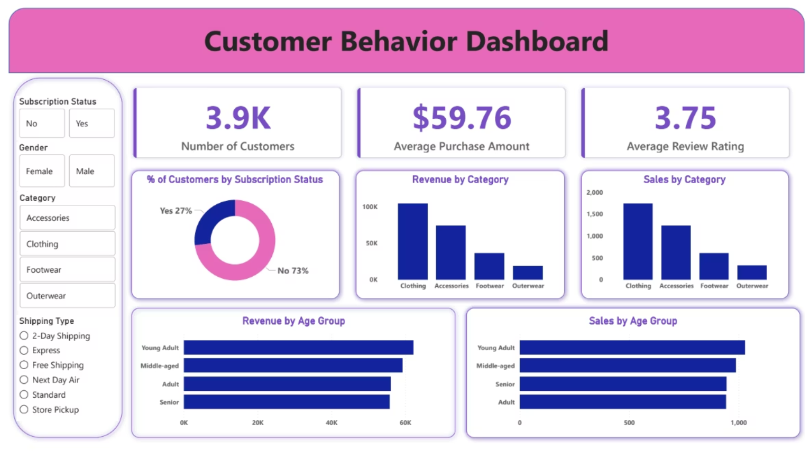
Customer Behavior Dashboard & Combined Insights
Customer Behavior Dashboard
Combined Insights Across Dashboards
Analyze demographics, subscriptions, rating scores & category performance.
Sales and credit card dashboards show strong Q4 growth patterns.
Customers: 3.9K, Average Purchase: $59.76, Average Rating: 3.75
Weather data can be combined with sales for climate-based demand forecasting.
73% of customers have no subscription—opportunity for upsell.
Customer behavior aligns strongly with income, job type, and card category.
Highest revenue categories: Clothing & Accessories.
HR attrition patterns highlight areas for employee retention strategies.
Middle-aged customers generate highest revenue; young adults highest purchases.
Age directly influences revenue; subscriptions lead to higher average purchase.

Slide 10
Conclusion: Advanced Analytics Capabilities
This multi-dashboard Power BI portfolio demonstrates advanced analytics capabilities across several business domains, including sales, HR, finance, customer behavior, forecasting, and weather intelligence.
BI Development
Data Analysis
End-to-end dashboard creation.
Extracting meaningful insights.
Forecasting
DAX & Modeling
Predictive modeling for future trends.
Complex calculations and data structures.
Data Visualization
Business Insights Storytelling
Clear and impactful presentations.
Translating data into actionable strategies.

